Slide 1

Lottory
Digital ID
DApp
Group Chain Your Life
Zheng Zi Yue
Chong Hao Yi
Gan Qi Wen

Slide 2
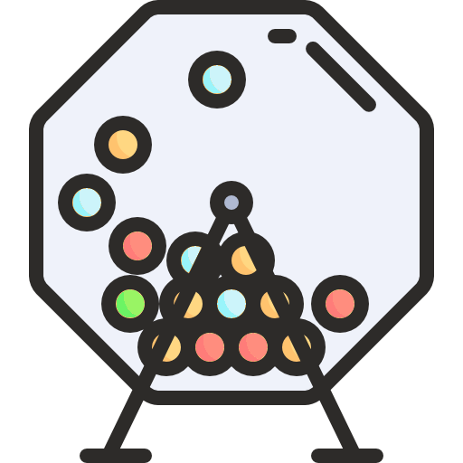
As a Lottory Company (Objective)
We want to protect our customer privacy and identity, allow them to make bet and receive the rewards anonymously.
We need to record all the transaction made by the customer.
We want to serve our customers better (privilege) if they have better priority (means when they bet more).
We want to build trust with our customer because smart contract wont allow any party to
run away if run out of money (need to have sufficient Ethereum for each bet include the house) .
We do not want to have intermediaries (broker) to deceive our customer (eliminate fraud).

Slide 3

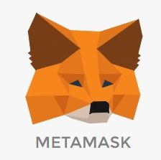


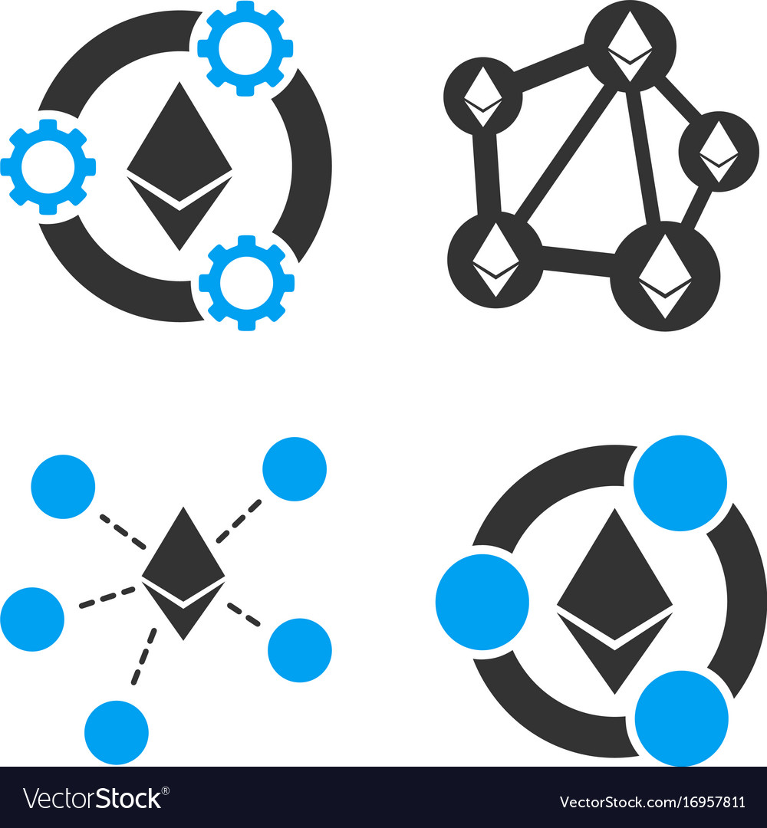

How this Dapp works

Slide 4


What we have done and not done
User/ Customer can bet the lottery using Ethereum as token. Also receive the rewards in the form of Ethereum.
The other customer can view the public information such as bet amount, bet date (basically for lottery company). Private information stored in the hash address such as amount of money own and personal details.
The priority of the customer increase when the time of transaction increase.

Slide 5

Not done
Implement the project to a wider user case scenario such as online or offline casino.
User sharing information not enhanced. Use Public information can be access by anyone without any action to revoke sharing permission.

Slide 6
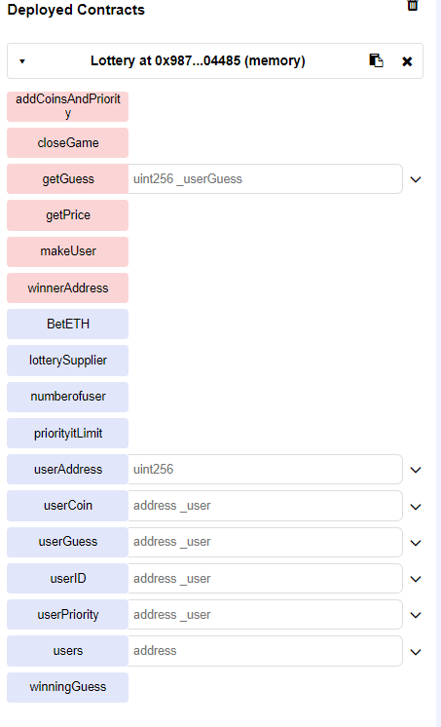
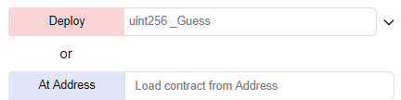
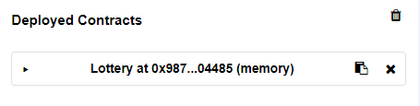
Lottery.sol demo

Slide 7
